Slide 1
Hadoop Configurations

Slide 2
Session Content (Hadoop Configuration)
Blocks versus splits
Hadoop Architecture – Map Reduce Process Flow (Previous Session Slides)
Hadoop Machine Configuration Requirements
Hadoop Installation Modes
Important Configuration Files
Hadoop Eco System Components
HDFS Commands
Running first Hadoop example
Checking other examples in the CDH

Slide 3
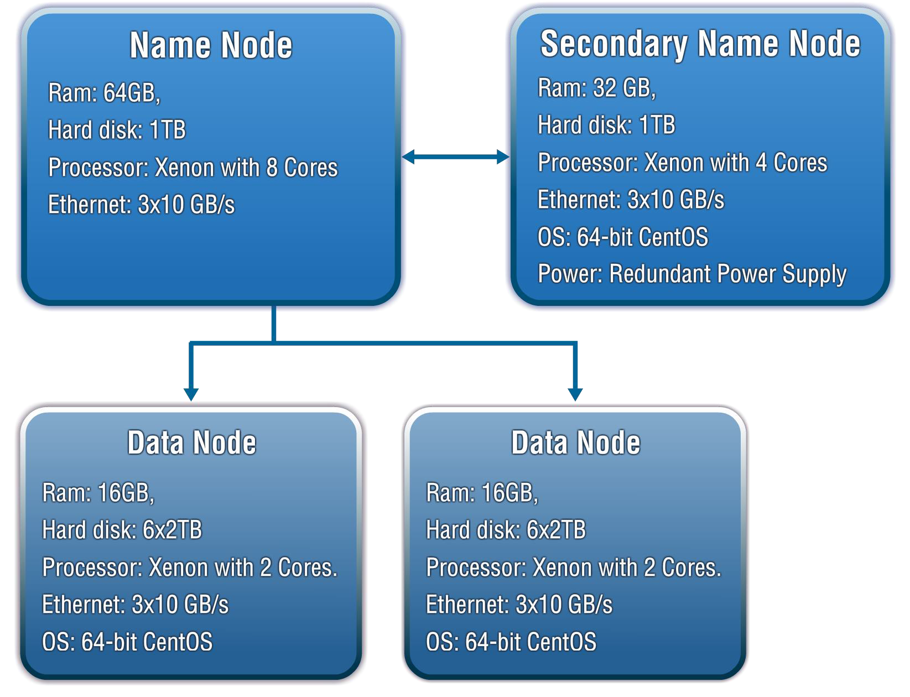
Hadoop Machine Configuration

Slide 4
Hadoop Installation Modes
Stand Alone (or local) Mode
There are no daemons running in this mode
It is usually used for initial installation testing or development purpose
Pseudo-Distributed Mode
Here the daemons run in separate process but on the same machine.
Used for production like simulation testing, just before delivering the code to production.
Fully Distributed Mode
Actual production environment comes into picture with Admin node and commodity machines in the cluster
Used for production environments

Slide 5
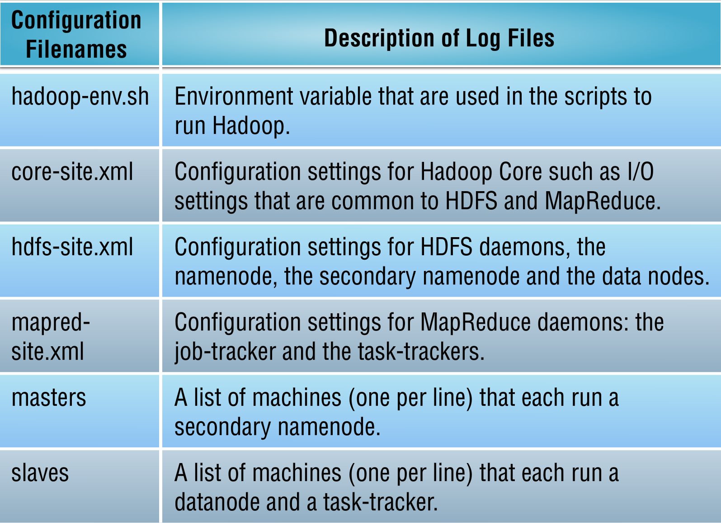
Hadoop Configuration Files

Slide 6
Hadoop Configuration Files
Hadoop-env.sh
Located at /etc/hadoop/conf
Important properties to set here :-
JAVA_HOME (set at /etc/profile)
Other MEMORY / HEAP related properties can be set here.
core-default.xml
fs.defaultFS – defines the URI for the cluster, identified by a scheme and authority. E.g - hdfs://quickstart.cloudera:8020, where hdfs is the scheme and //quickstart.cloudera:8020 is the host and port.
Hdfs-default.xml
dfs.replication – Defines the replication factor with default value as 3
dfs.blocksize – Defines the minimum block size in which HDFS should create the blocks.
dfs.namenode.name.dir – Defines where the namenode will save the metadata
dfs.namenode.checkpoint.dir – Defines where the secondry namenode will save the metadata
dfs.datanode.data.dir – Defines where the datanodes will store the blocks of files
dfs.namenode.rpc-bind-host – Defines the actual address the RPC or the namenode server binds to. Set to 0.0.0.0 for Hadoop 2.0 to enable multiple namenodes for HDFS Federation
dfs.namenode.http-address– The actual address that the HTTP / web server binds to

Slide 7
Hadoop Configuration Files (continued..)
mapred-default.xml
mapred.job.tracker – Defines the web address of the jobtracker. Applicable only for Hadoop 1.0. The resource manager (YARN) takes over in Hadoop 2.0
Mapred.framework.name – the runtime framework for running map reduce jobs. The default is local and other values could be classic or YARN.
Mapreduce.tasktracker.maps.tasks,maximum– the maximum number of map tasks that will be run by the task tracker.
Mapreduce.tasktracker.reduce.tasks,maximum– the maximum number of reduce tasks that will be run by the task tracker.

Slide 8
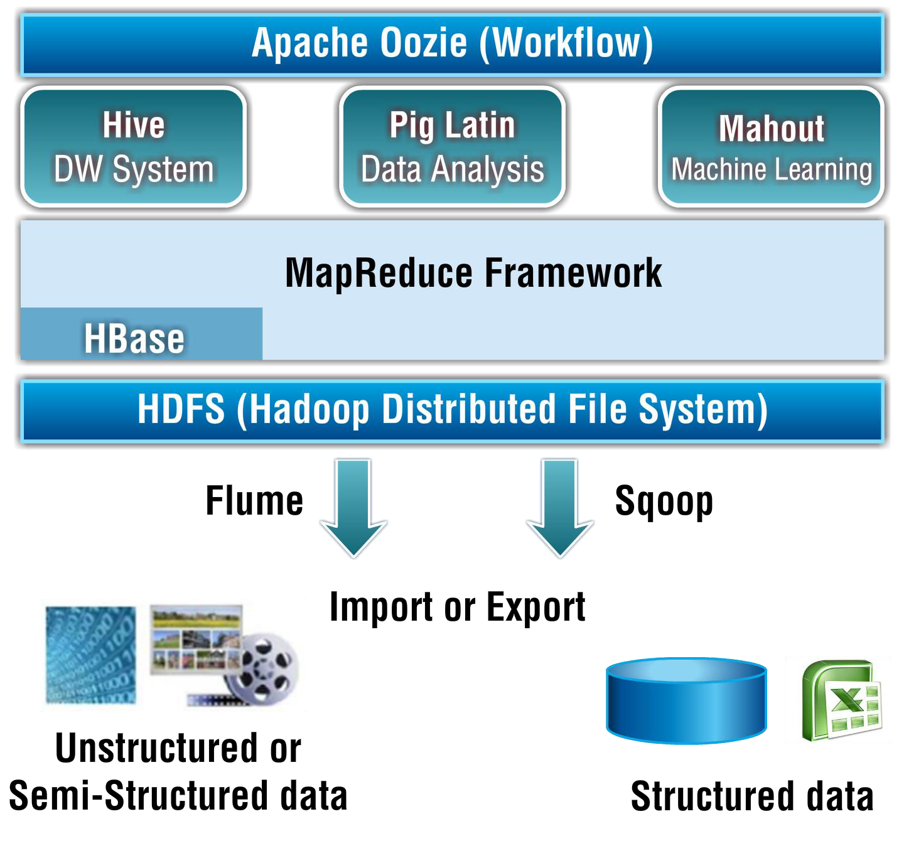
Hadoop Eco System Components

Slide 9
HDFS Commands
Hadoop Version
hadoop version – Tells the version of hadoop / cdh installed
LS Command
hadoop fs – ls / – Displays the list of files and directory in HDFS File path
MKDIR Command
hadoop fs – mkdir /direcory_name – creates the directory in HDFS
TOUCHZ Command
hadoop fs -touchz /directory-name/file_name – creates the file HDFS with a size of 0 bytes
DU Command
hadoop fs –du –s -h /directory-name/file_name – displays summary of file lengths
CAT Command
hadoop fs –cat /directory-name/file_name – displays file to stdout
CAT Command
hadoop fs –cat /directory-name/file_name – displays file to stdout

Slide 10
HDFS / Hadoop Resources
HDFS File System Guide
Yahoo Hadoop Tutorial

Slide 11
Running the word count example

Slide 12

Queries on Unit

